Slide 1
Bioreactor System Dynamic Model Analysis
Group No. 08
Tushar (2022CHB1059) Akhil (2022CHB1039)

Slide 2
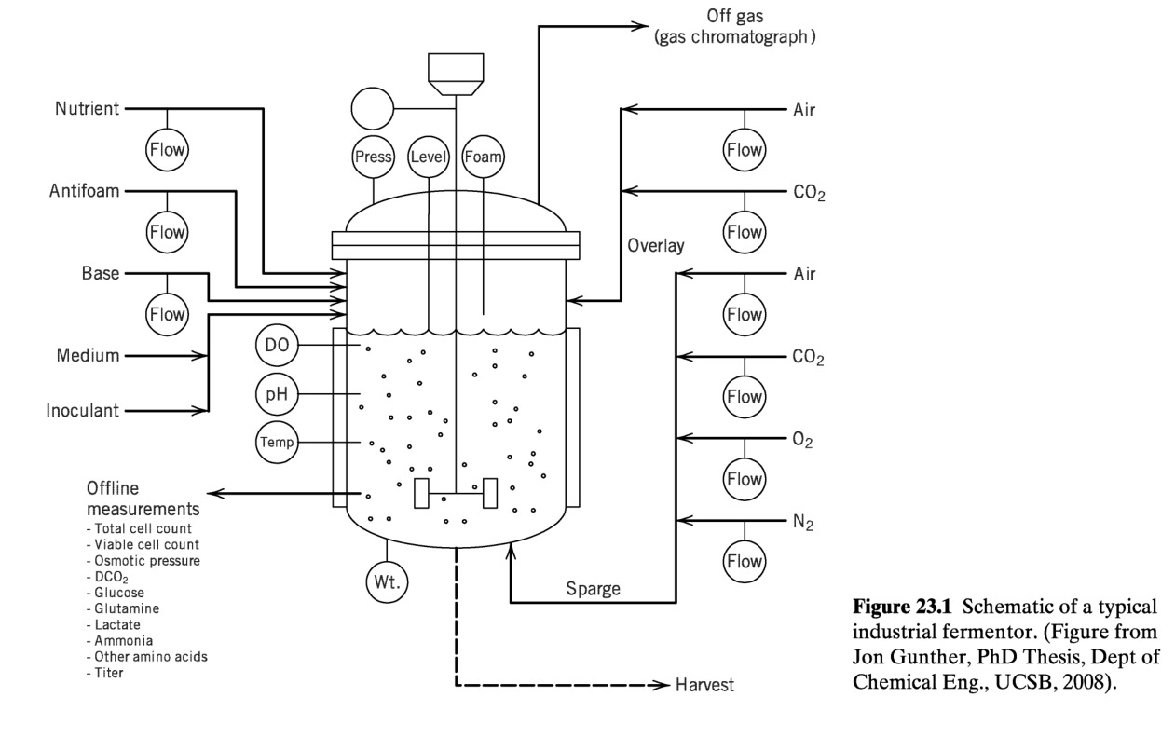
Introduction to Bioreactor Systems
• A bioreactor is a vessel used to carry out biological reactions involving cells or microorganisms.
• Applications include pharmaceuticals, waste treatment, and food processing.

Slide 3
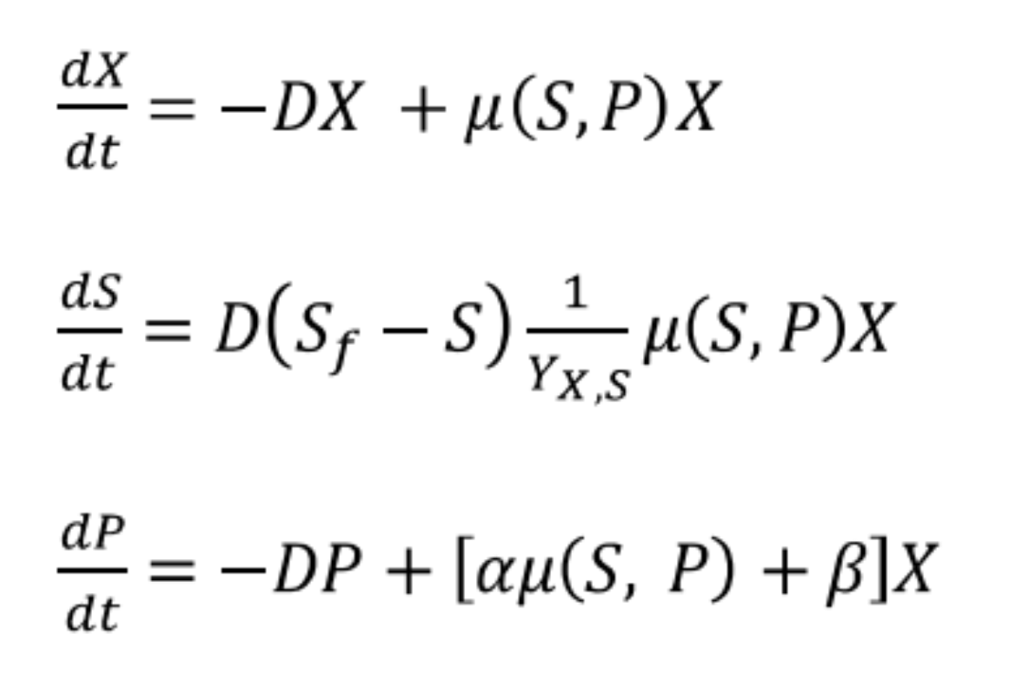
System Description
• The material balances for biomass (X), substrate (S), and product (P) concentrations describe the system's dynamics.
• Assumes a constant reactor volume, focusing on concentration changes due to biological reactions and dilution rate (D).

Slide 4
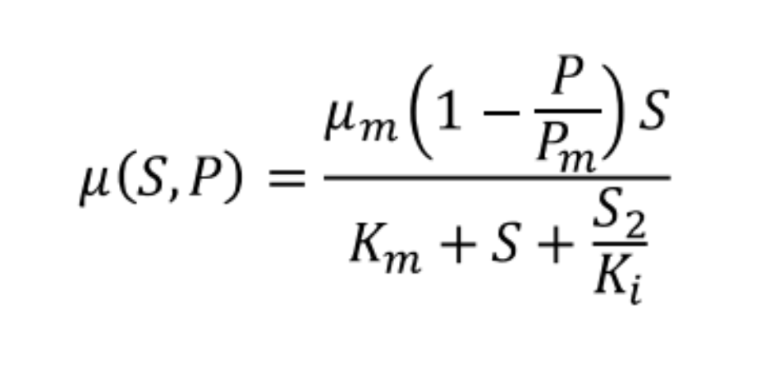
Growth Rate Kinetics
• Traditional Monod equation models growth based on substrate concentration.
• This model accounts for inhibition from both substrate and product:

Slide 5
Model Parameters
The following are the parameters used in the bioreactor model:
Parameter | Value
Yx/s | 0.4 g/g
β | 0.2 h⁻¹
Pm | 50 g/L
Ki | 22 g/L
α | 2.2 g/g
μm | 0.48 h⁻¹

Slide 6
Classification of Variables
Controlled Variables: Biomass (X), Substrate (S), Product (P)
Manipulated Variables: Dilution Rate (D)
Disturbance Variables: Yield Parameters (Yx,s ,α, β), Substrate & Product Concentrations

Slide 7
Objectives of Task 1
• Understand dynamic behavior of the bioreactor system
• Perform steady-state and dynamic simulations
• Identify FOPTD model parameters and validate the model performance

Slide 8
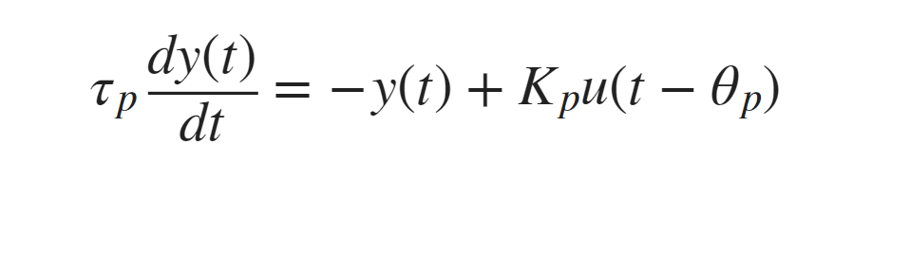
INTRODUCTION
After gaining an intuitive understanding of how the parameters influence the step response, it is important to understand the mathematical FOPDT equation. The equation
has variables y(t) and u(t) and three unknown parameters.
Kp= Process Gain
τp= Process Time Constant
Ɵp= Process Deadtime

Slide 9
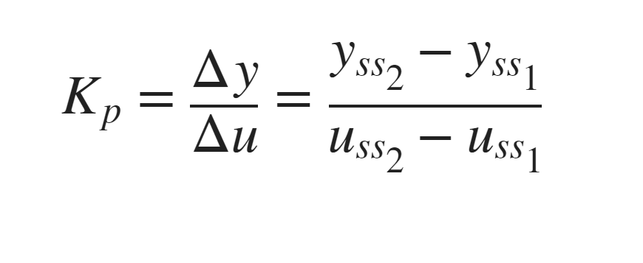
Process Gain (Kp)
The process gain is the change in the output y induced by a unit change in the input u. The process gain is calculated by evaluating the change in y(t) divided by the change in u(t) at steady state initial and final conditions.
The process gain affects the magnitude of the response, regardless of the speed of response.

Slide 10
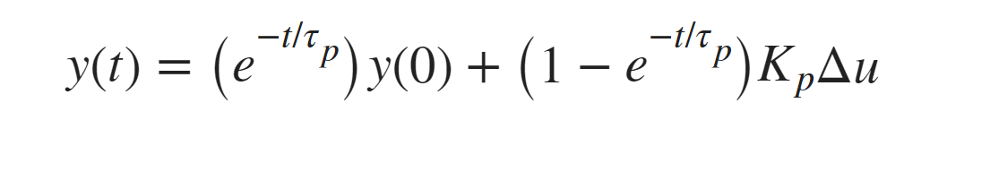
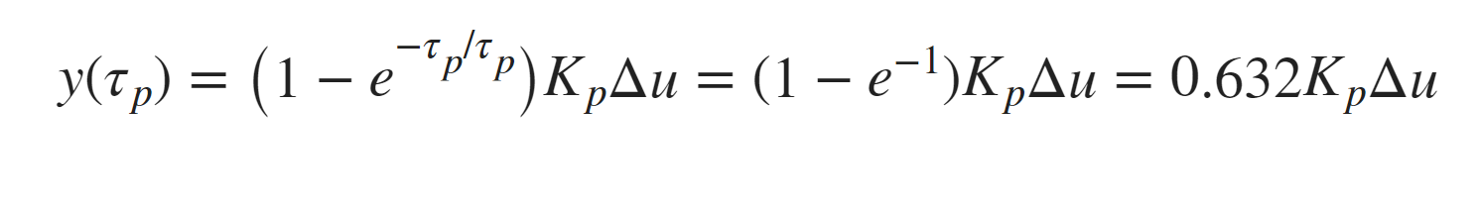
Process Time Constant (τp)
Given a change in u(t)=Δu, the solution to the linear first-order differential (without time delay) becomes:
If the initial condition y(0)=0 and at t=τp, the solution is simplified to the following.

Slide 11
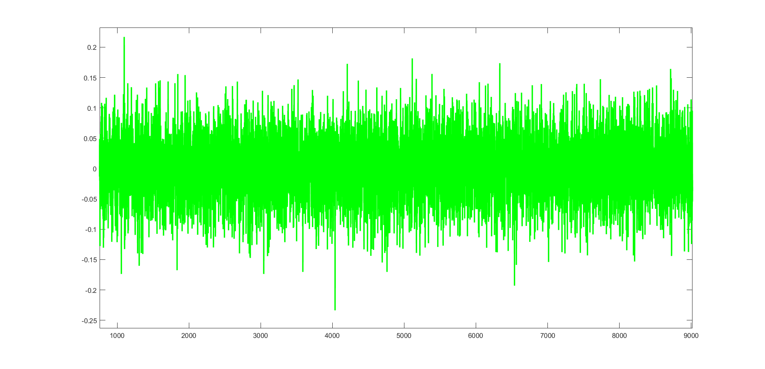
Dynamic Simulation
Simulation of different step changes in dilution rate or feed substrate concentration. Compare results using ODE45 (nonlinear).

Slide 12
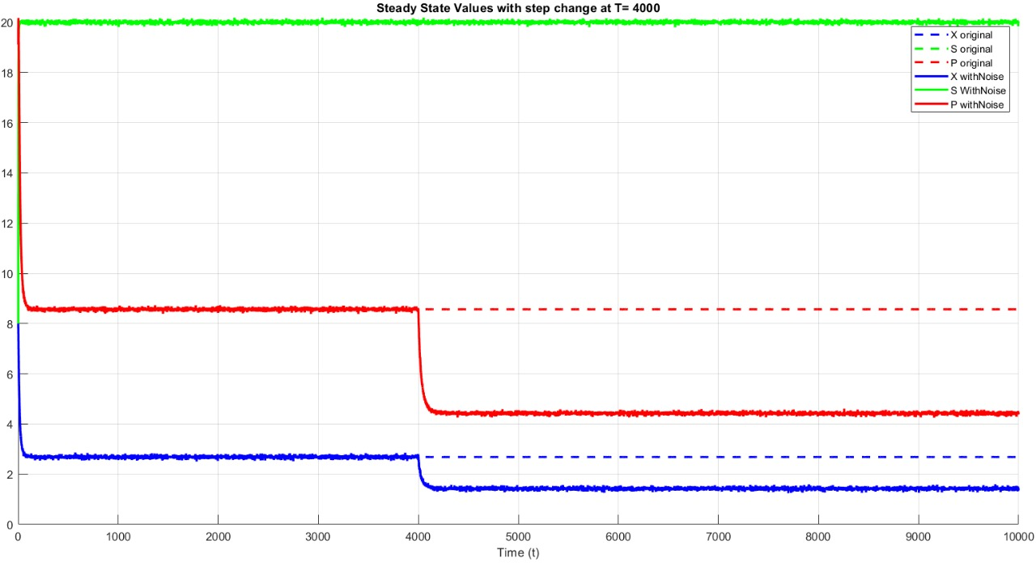
INITIAL STEADY STATE GRAPH WITH STEP CHANGE IN D OF MAGNITUDE = 0.0202
Original Training curve for a step change

Slide 13
Steady State Simulation
Initial Steady State values (in concentration) :
X= 2.69
S= 19.97
P= 8.48
Steady State values after Step Change (in concentration) :
X= 1.49
S= 20.01
P= 4.54

Slide 14
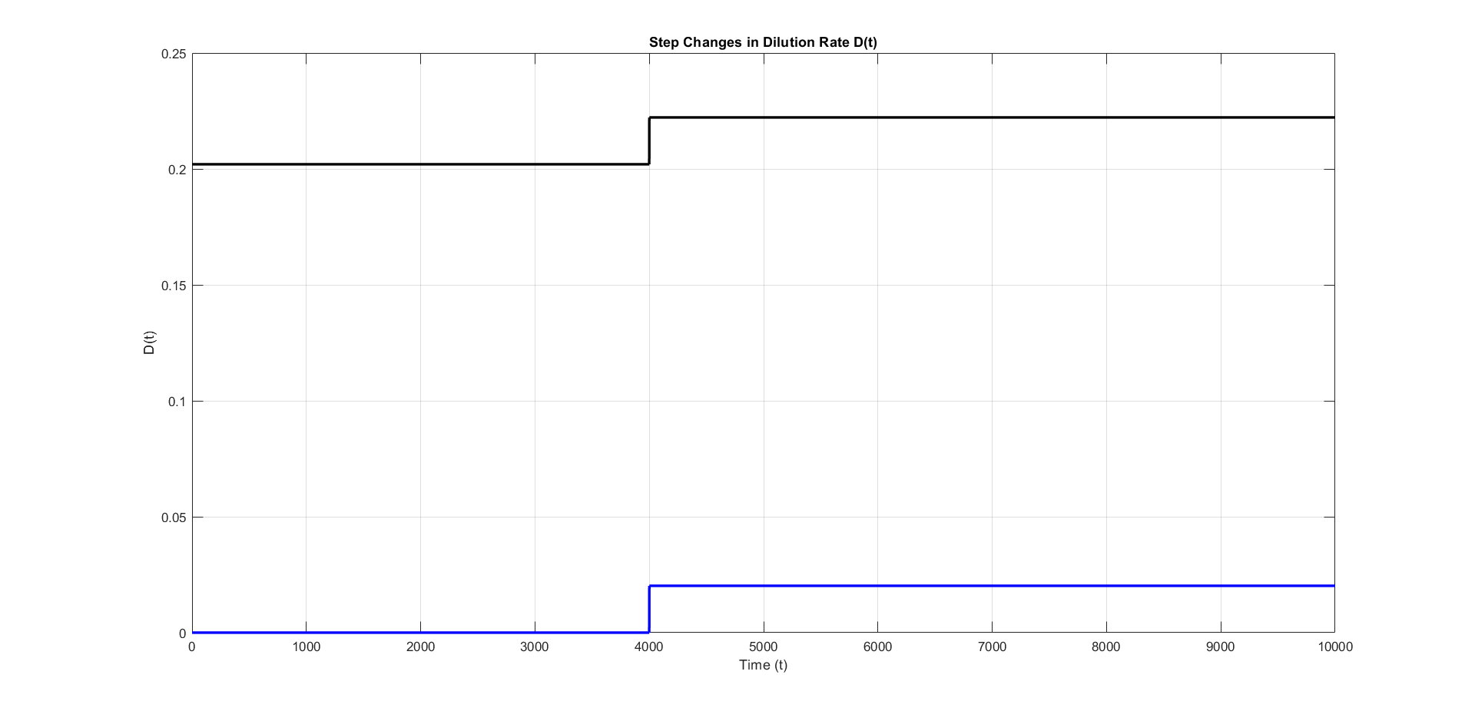
STEP CHANGE PLOT (ORIGINAL AND NORMALIZED)
D @ T<4000 = 0.202
D @ T>4000 = 0.202+0.0202 (10%)

Slide 15
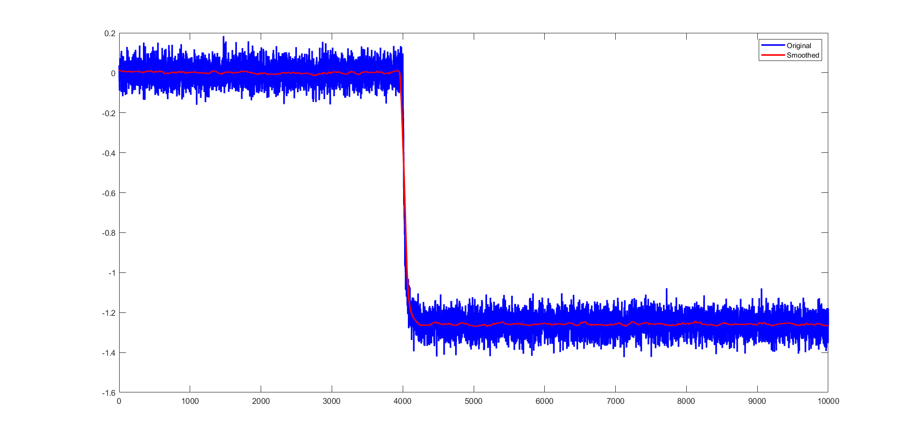
Initial biomass train data (Normalized)

Slide 16
Empirical Model Identification
• Reporting training and testing data
• Outlining FOPTD model identification steps (process gain, time constant, delay)
• Validating model by comparing predicted vs Actual data
We are doing all of this on Normalized data i.e. only Transient system analysis without steady state.

Slide 17
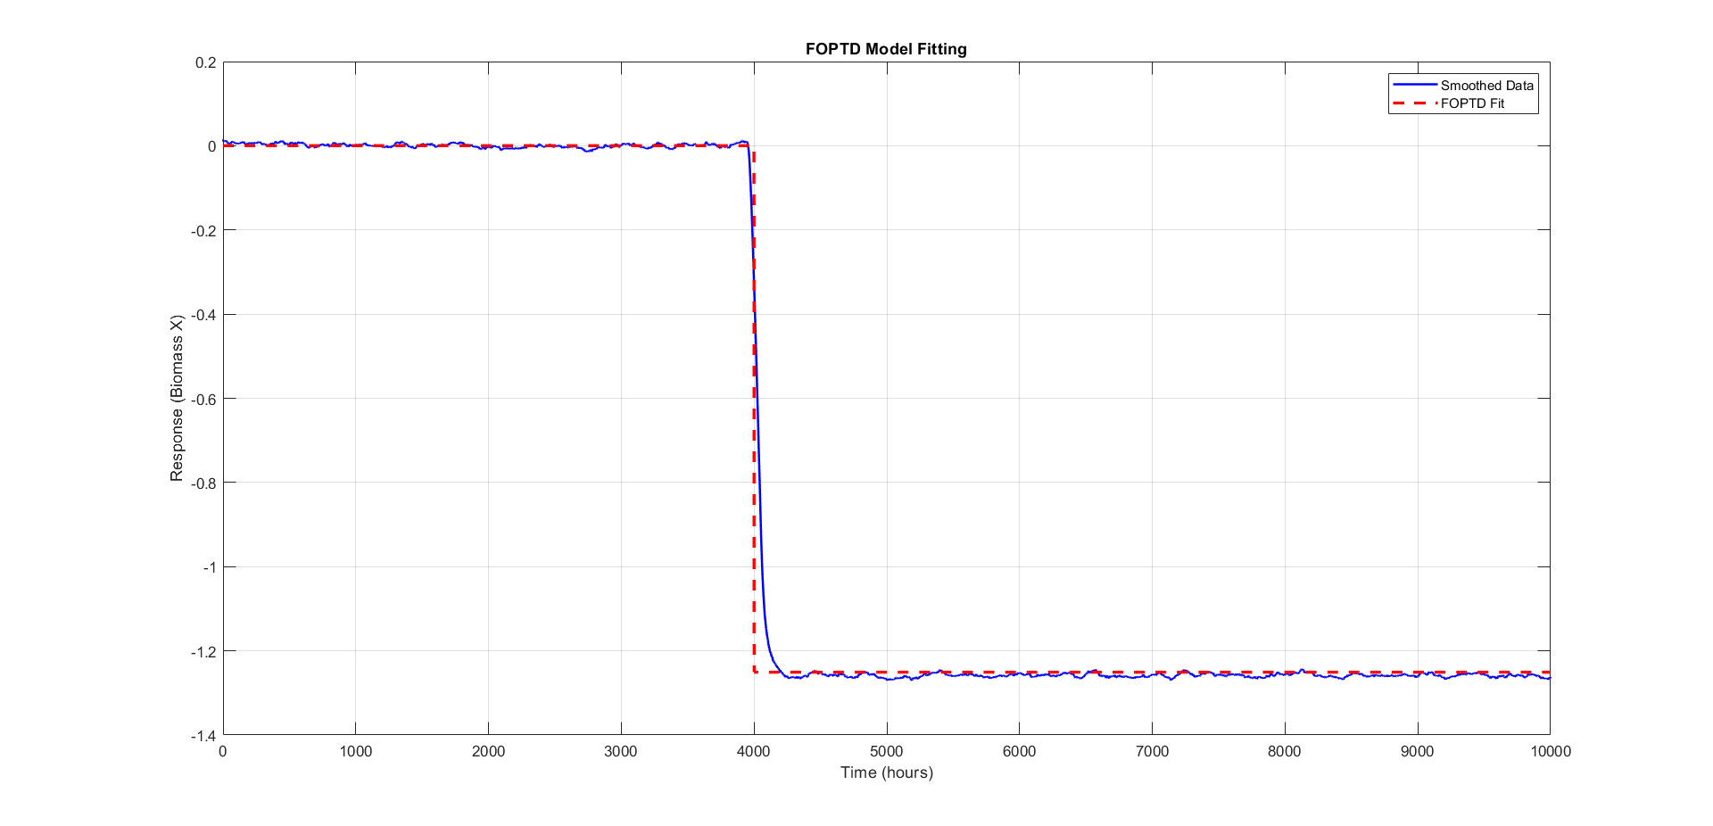
Foptd model plot fitting and parameters (biomass)

Slide 18
PARAMETER VALUES
Here we have choose 1st order plus time delay model and the parameters are as follows:
Kp= -61.94
τp= 175.37
Ɵp= 30.79

Slide 19
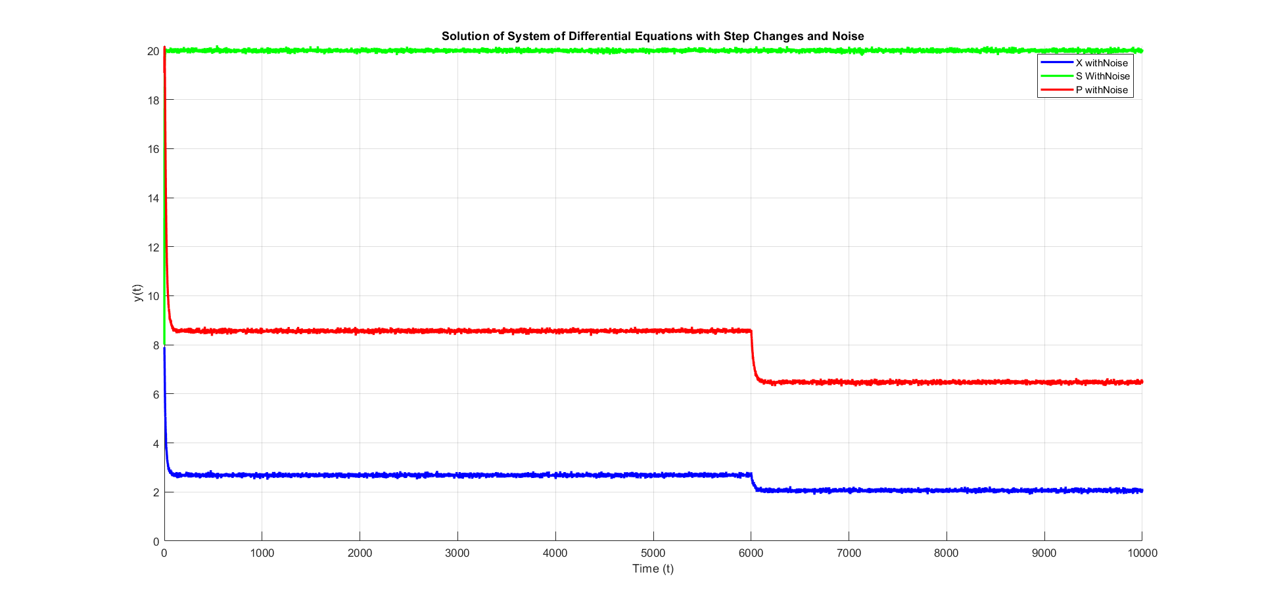
VALIDATION DATA PLOT

Slide 20
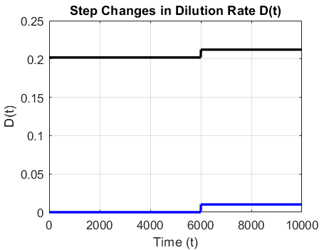
Step change validation (total and normalized)

Slide 21
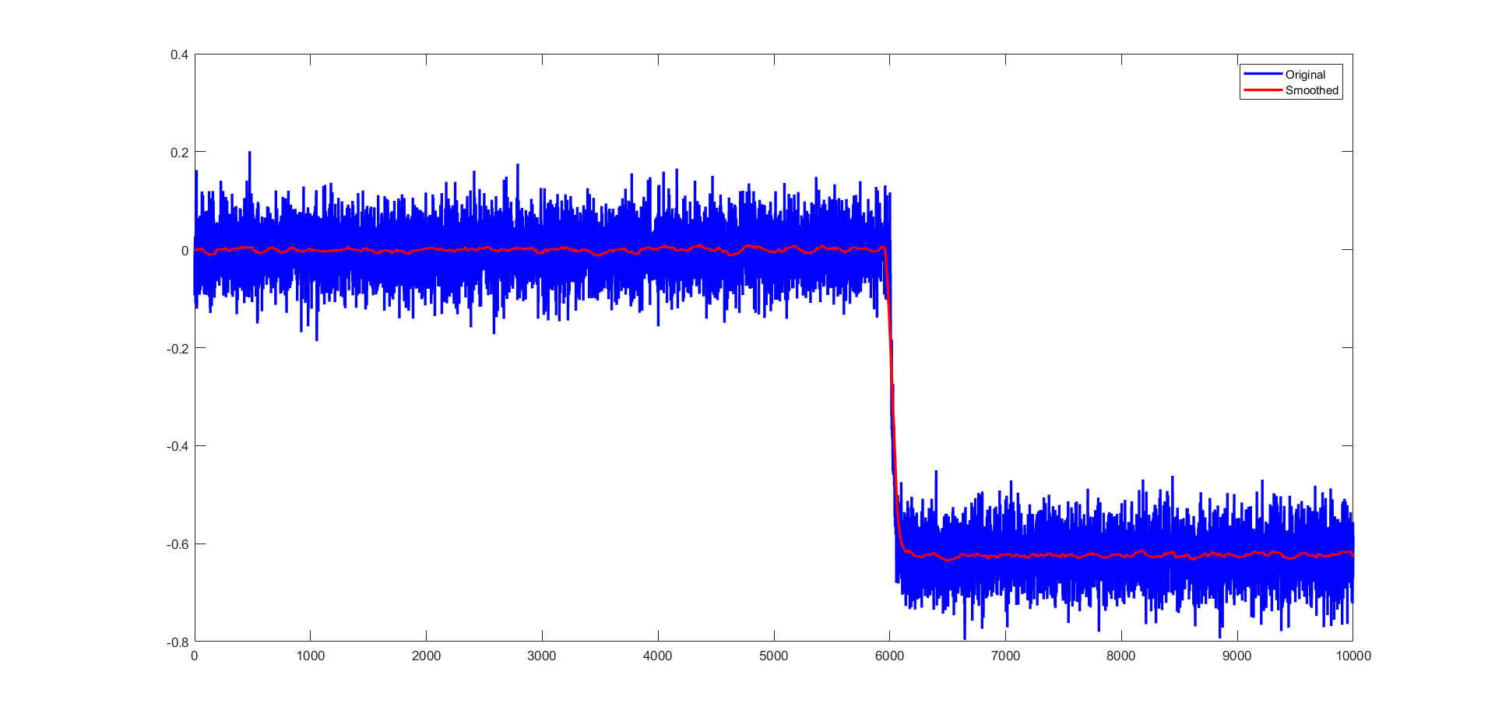
Validation biomass data

Slide 22
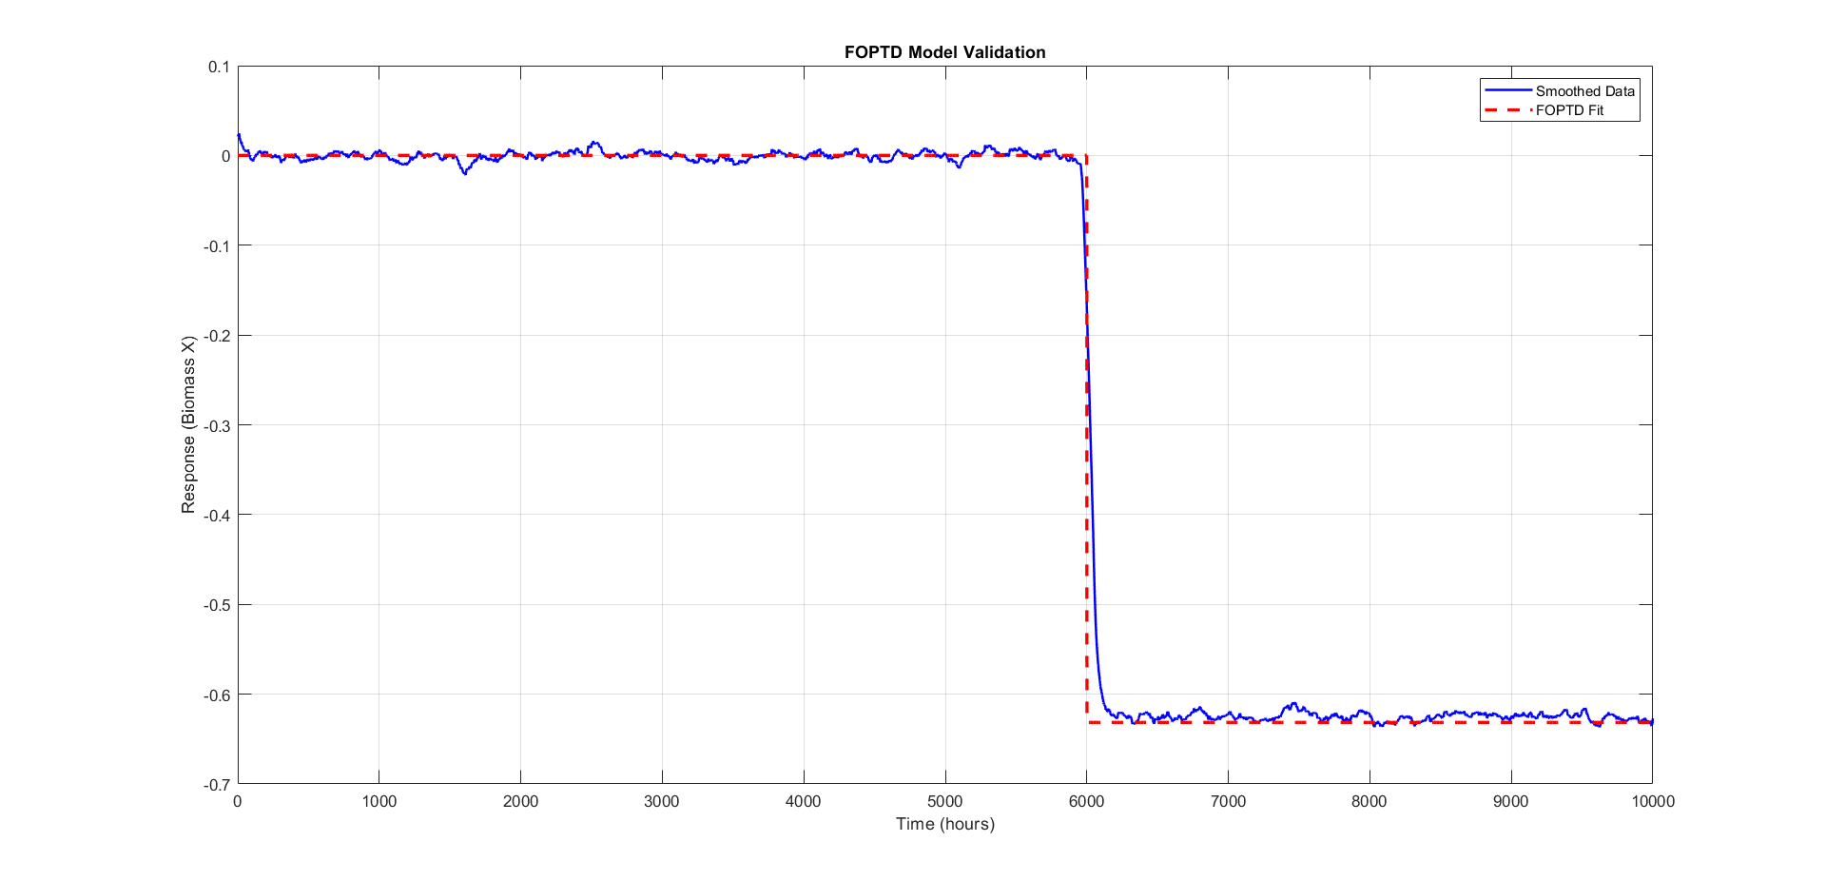
Foptd validation
The predicted FOPTD model beautifully fits the validation data which has different step change magnitude as well as different time of step change.

Slide 23
Conclusion
We successfully generated noisy data for the system under study, incorporating realistic uncertainties. Using this data, we developed a First-Order Plus Time Delay (FOPTD) model, which was then fitted and validated against the system's behavior.
The FOPTD model proved effective in capturing the system's dynamic responses, including step changes and time delays, providing a simplified yet accurate representation of the process.
This model is particularly useful for control system design and tuning, as it allows for easier parameter estimation and prediction of system behavior under various conditions, making it a valuable tool in process optimization and performance improvement.

